Slide 1
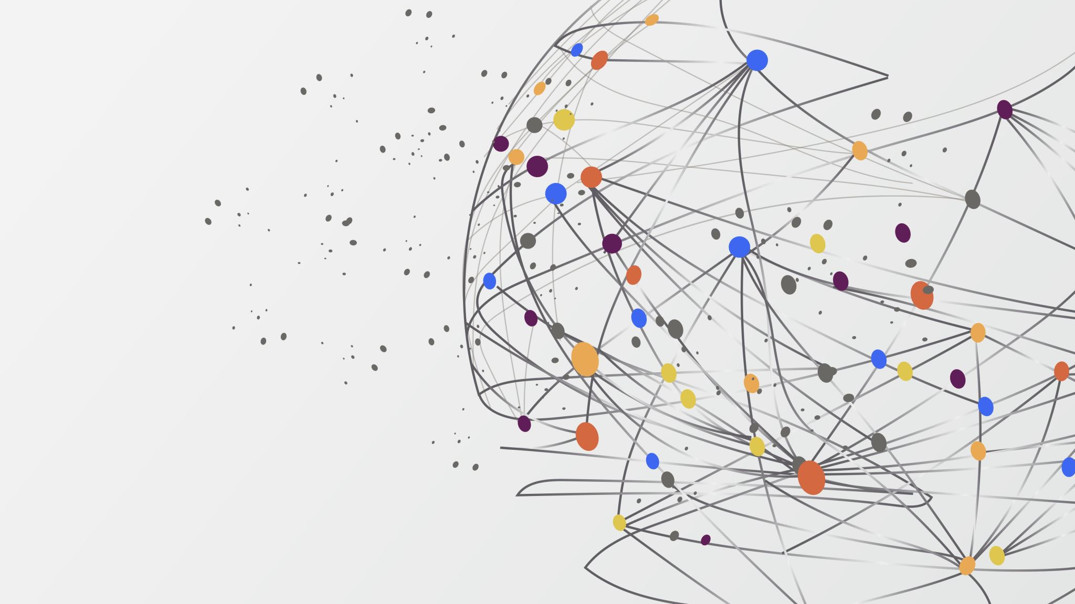
Skill Recommendation System
Team 10
Rishikesh Fulari
Rohan Patel
Yash Bhandare
Martin Vivas

Slide 2

Problem statement
Aim of this project is given a resume of a user the “skill recommendation engine” should be able to suggest the skills that are needed for a user to reach a targeted position in the market. For example,
Target position: Data Scientist
Current skill sets: Python, Web Scraping, Data Analysis
Recommended Skills: Deep Learning, Machine Learning, NLP etc.,

Slide 3

TEAM CONTRIBUTIONS
Rishikesh – ML Clustering Approach, Dataset
Rohan – Skills2Vec Approach, Dataset
Yash – Team Lead, Deployment, Data Cleaning and Conditioning
Martin – Front-end, Back-end, Documentation

Slide 4

Tools and Technologies
Libraries Used​
Yellowbrick​
sentence-transformers​
KElbowVisualizer​
WordCloud​
Tqdm​
K-means++​
Skills2Vec​
Sklearn​
Pandas​
Numpy​
Streamlit
Development Environment
Jupyter Notebooks IDE
Deployment
Hugging Face Spaces
Version Source Control
GitHub
Software Requirements
Python 3
Jupyter Notebooks
Anaconda Navigator
Browser

Slide 5
APPROACH
We followed 2 approaches:
ML and Clustering Based Approach
Skills2Vec Data Model Based Appraoch

Slide 6
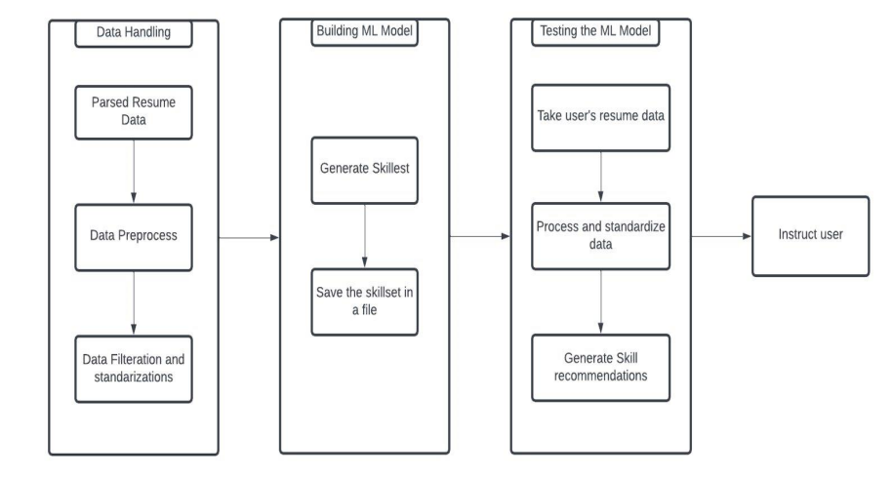
System Overview

Slide 7
CLUSTERING APPROACH
Used sentence transformers on job description texts to vectorize the sentences and extract skills.
Used KMeans++ clustering to form clusters of skills and job titles.
Create extraction algorithm for job titles and associated skills using word clouds generated based off clusters.
Cleaned the unnecessary words identified as skills and transformed results into a dictionary

Slide 8
Skills2Vec APPROACH
Open Source Framework referenced by the client
Vectorizes skills and matches to job descriptions
Provided with raw data of skills matched to job titles
Manual Preprocessing and conditioning

Slide 9

Challenges Faced
Unavailability of data
Changing requirements
Complex problem with an extremely large scope

Slide 10

accomplishments
Team Coordination
Documentation in form of assignments
Properly implemented agile team process
Fast grasp on changing requirements
New technologies learnt

Slide 11

Demo
https://huggingface.co/spaces/rishikesh/skillRecommendationEngine

Slide 12

Future Scope
Implement resume parser using named entity recognition
Automated skills extraction using NLP techniques
Enhanced robustness to work flawlessly with datasets from multiple professional streams
Enhanced UI with functionalities like resume scorer and ATS analysis.

Slide 13

Thank You
Q&A

